Slide 1
St. Petersburg, 2016

Slide 2
Lecture 5. Experiment and Classical Science of Modern Age
Alexander A. Lvov, PhD
camenes@yandex.ru
St. Petersburg, 2016

Slide 3
Agenda
Two mainstreams in the philosophical thought of Modernity: Bacon and Descartes
Experiment as a criterion of certainty
Great classifications. The Encyclopedia phenomenon
Immanuel Kant’s philosophy of freedom

Slide 4
Modern Philosophy
Empiricism
Rationalism
Founder: F. Bacon
Followers: Th. Hobbes, J. Locke, D. Hume, J. S. Mill, B. Russell, A. J. Ayer, analytic philosophers.
Idea: any knowledge is based on empirical data and deduce from them.
Hegel: «All that is speculative is pared and smoothed down in order to bring it under experience».
Founder: R. Descartes
Followers: B. Spinoza, G. W. Leibnitz, I. Kant, G. W. F. Hegel, K. Marx, the idealists.
Idea: any knowledge is based on reason and deduce from it.
Hegel: «The second method <…> proceeds from what is inward; according to it everything is in thought, mind itself is all content».
«Here, we may say, we are at home, and like the mariner after a long voyage in a tempestuous sea, we may now hail the sight of land». G. W. F. Hegel

Slide 5
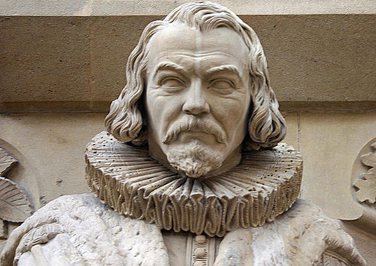
Sir Francis Bacon’s empiricism (1561 – 1626)
The project of the great instauration of sciences is an attempt to found a systematical scientific knowledge about the world independently from Aristotle (and the scholastics)
Knowledge is power; as we possess the right method of research of nature, we can get correct data, therefore, the exact knowledge
We make tables, and this if the way how to systematize the data we have obtained. Bacon is the founder of the method of induction
«Truth is Time’s daughter, not Authority’s».

Slide 6
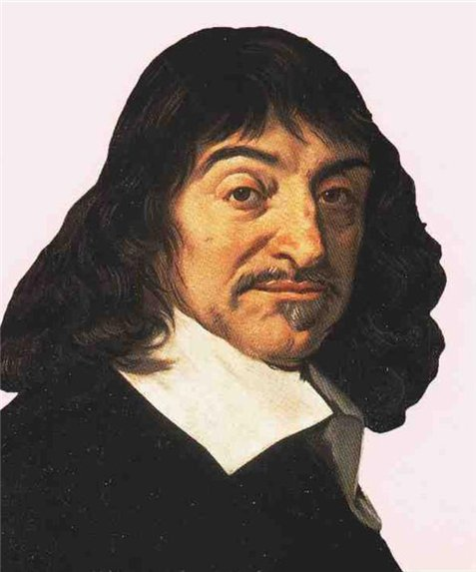
Rene Descartes’s Rationaliism (1596 – 1650)
He was educated at the Jesuit College at La Flèche, where he studied philosophy, languages, poetics and rhetoric
Meditation on First Philosophy (1641) is the book in which he introduced the principles of true knowledge. The main purpose is the demonstration of God’s existence as simplest and most obvious thing.
The radical doubt procedure. Cogito, ergo sum («I think, therefore, I am»).
«It is impossible to reach any knowledge lest via the intuition of the reason and deduction»

Slide 7
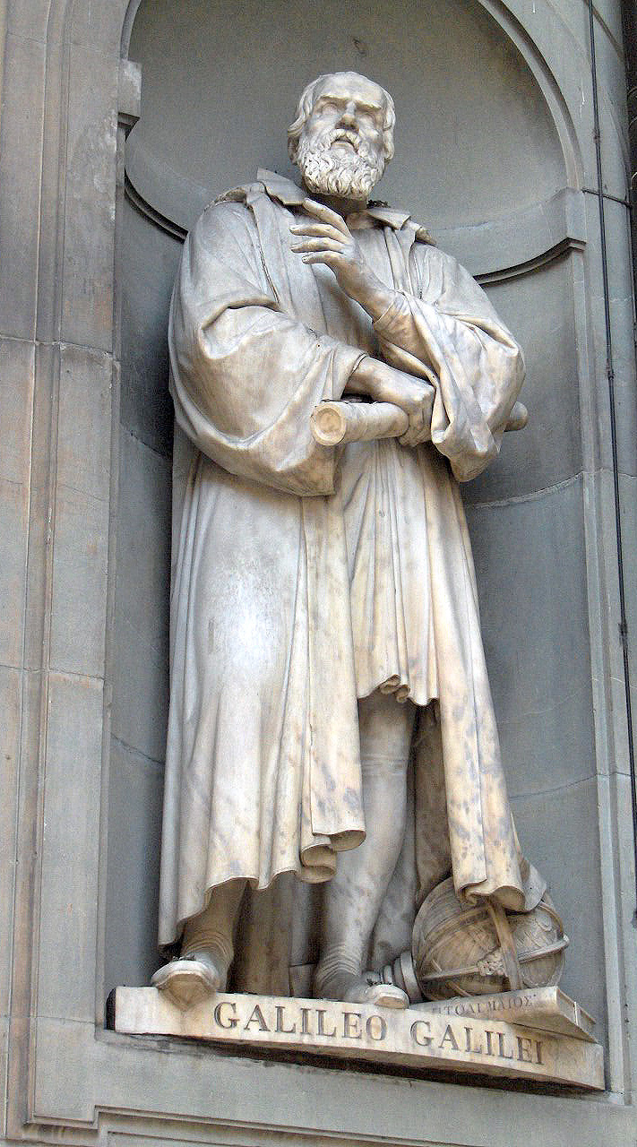
Experiment as a criterion of certainty
Galileo Galilei (1564 – 1642) elaborated the principles of mathematical approach to the study of nature
He was the first who used telescope to observe celestial objects and phenomena (in 1609)
In 1632 he published Dialogue Concerning the Two Chief World Systems, in which he expounded his observations.
He invented pendulum, studied inertia and the free fall of bodies, and elaborated the principles of classical mechanics
“The book of nature is written in the language of mathematics. The letters of its alphabet are triangles, circles, and other geometrical shapes” (Galileo)
«Galileo died in the year when Isaak Newton was born. This is the celebration of Christmas of our Modernity» (J. W. von Goethe)

Slide 8
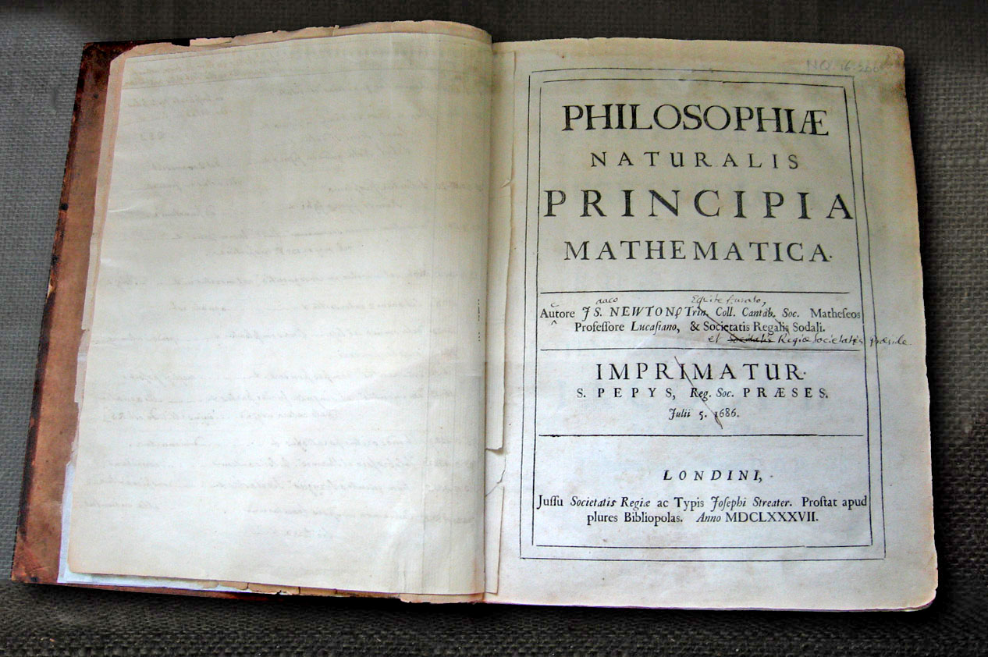
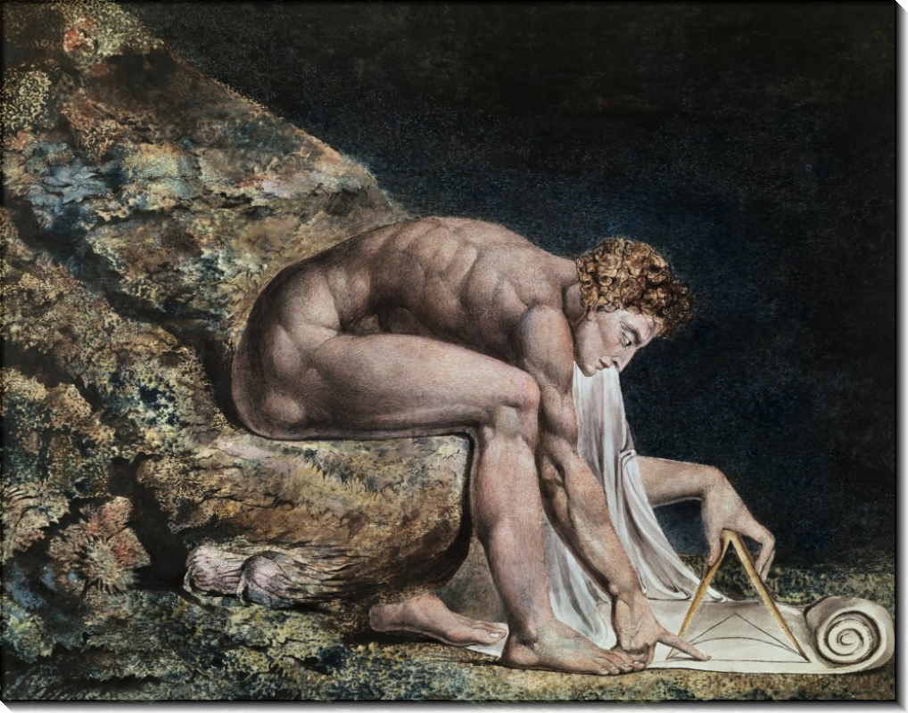
Experiment as a criterion of certainty
Sir Isaak Newton (1642 – 1727)
Studied and taught at Cambridge; the President of Royal Society (since 1703).
He brought the basis to physics as a systematic study of natural phenomena in his great and very influential Philosophiae Naturalis Principia Mathematica, 1687. There three laws of motion (Newton’s laws) and the theory of universal gravitation are represented.
In his Opticks (1709) he described his experiments with light (with prism). He is considered to be the follower of the corpuscle theory of light.
«Hypotheses non fingo»

Slide 9
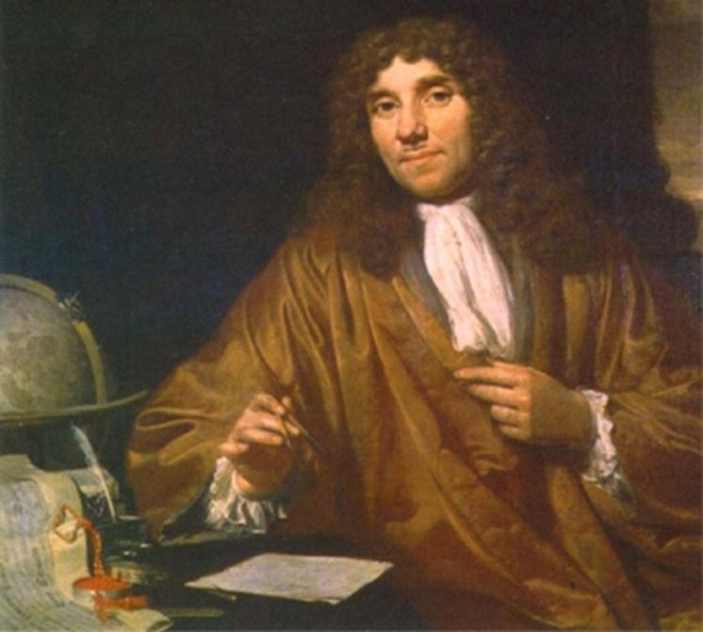
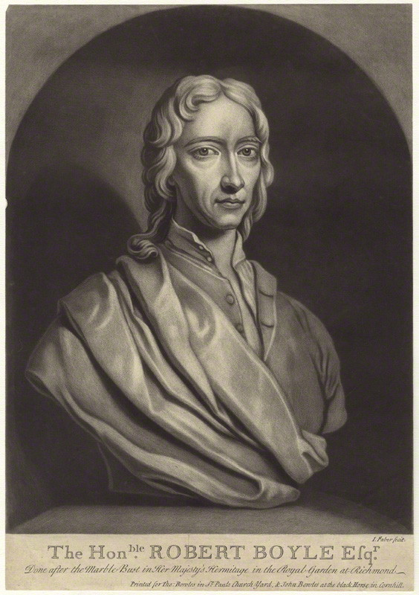
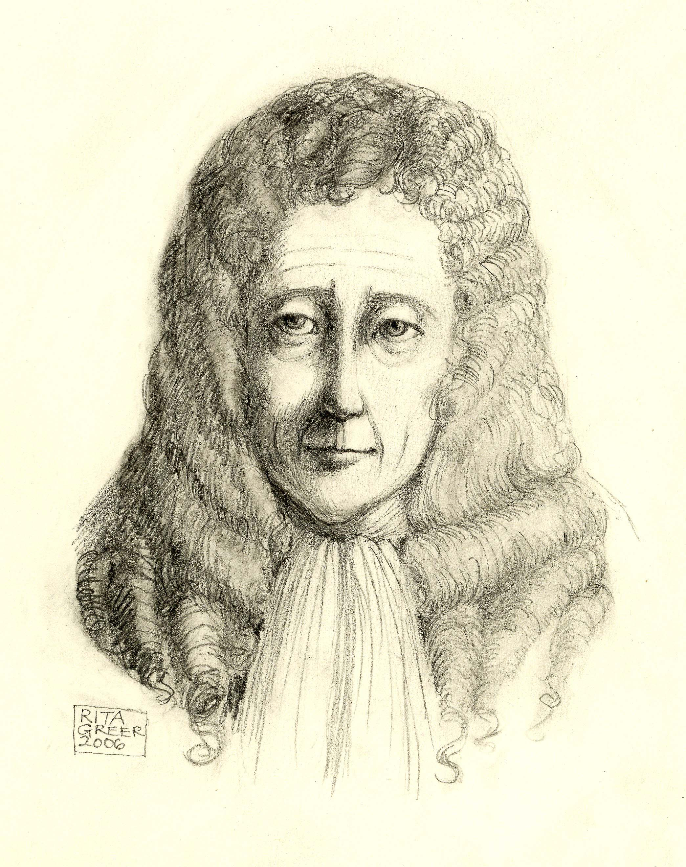
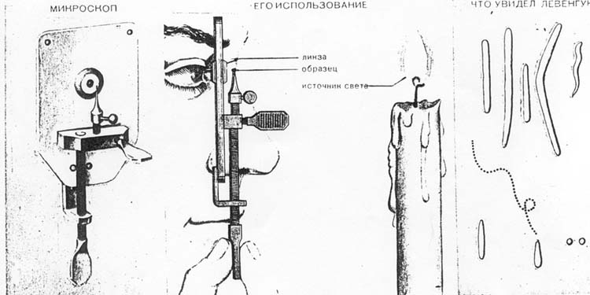
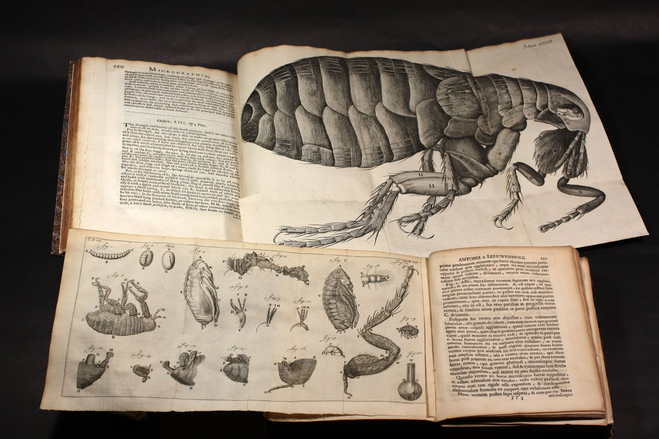
Experiment as a criterion of certainty
Robert Boyle (1627 - 1691) did experimental work on gas and air, and concluded, that air consists of tiny particles, for it can be pressed
Robert Hooke (1635 – 1703) wrote Micrographia (1665) and improved the construction of microscope
Antoni van Leeuwenhoek (1632 – 1723) was an enthusiastic student of nature who was the first to use the improved microscope in his investigations

Slide 10
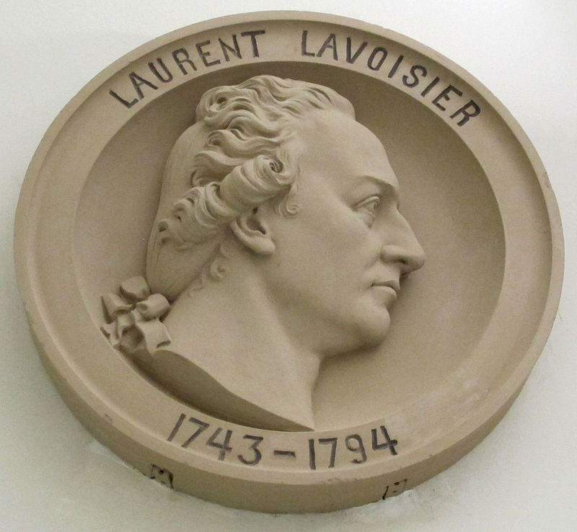
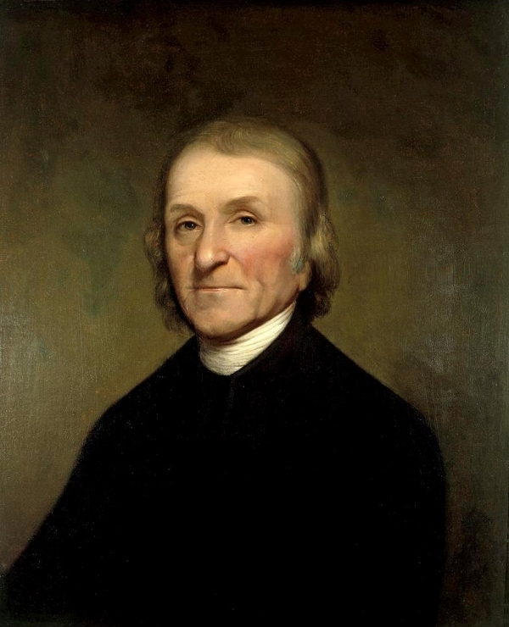
Experiment as a criterion of certainty
Robert Boyle (1627 - 1691) did experimental work on gas and air, and concluded, that air consists of tiny particles, for it can be pressed
Robert Hooke (1635 – 1703) wrote Micrographia (1665) and improved the construction of microscope
Antoni van Leeuwenhoek (1632 – 1723) was an enthusiastic student of nature who was the first to use the improved microscope in his investigations
Joseph Priestley (1733 – 1804) was the phlogiston theory proponent, and the discoverer of oxygen
Antoine-Laurent Lavoisier (1743 – 1794) was the founder of modern chemistry, he demonstrated that oxygen supports burning, he disproved the phlogiston theory

Slide 11
Francis Bacon’s classification of human knowledge (1)
History
Poetry
Reason
Natural
Civil
Applications
Epic
Dramatic
Parabolic
Theology
Philosophy
1.1 epic (events)
1.2 inductive
2.1 – natural
2.2 - first
2.1 – church
2.2 – scientific
2.3 – civil as such

Slide 12
Francis Bacon’s classification of human knowledge(2)
Natural Philosophy
First Philosophy
Mathematical
Theoretical
Practical
The doctrine of man
Civil science
On the nature of man
The philosophy of man
Axioms of sciences
1.1 – pure
1.2 - mixed
3.1 – on body 3.2 – on soul
2.1 – physics
2.2 - metaphysics
3.2.1 – on the types of soul
3.2.2 – on the capacities of soul
3.1 – mechanics
3.2 – magic
3.2.2.1 – ethics
3.2.2.2 – logic, et cetera

Slide 13
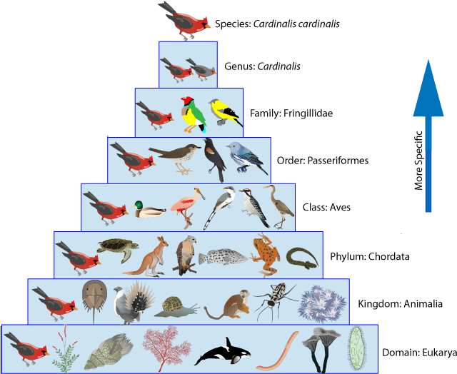
Carl Linnaeus’s taxonomy

Slide 14
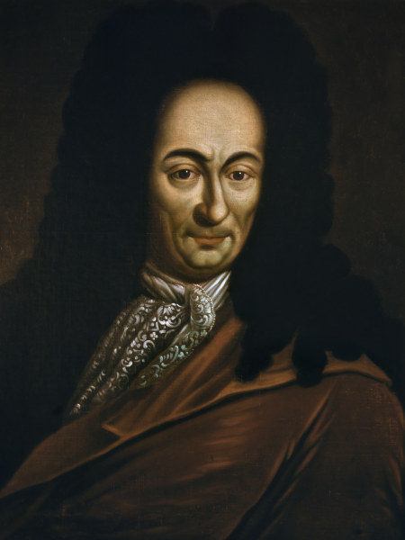
G. W. Leibnitz’s doctrine (1646 – 1716)
He became famous for his activities in: philosophy, physics, mathematics, logic, history and foreign affairs.
He justified principle of sufficient reason
He developed the doctrine of monads («Monadology») – simple and indivisible substances, the activity of which is in representation (they can be corporal, mental, more or less perceptible)
He taught about pre-established harmony. There is order in nature, and we live in the best of all the possible worlds (Theodicy).

Slide 15
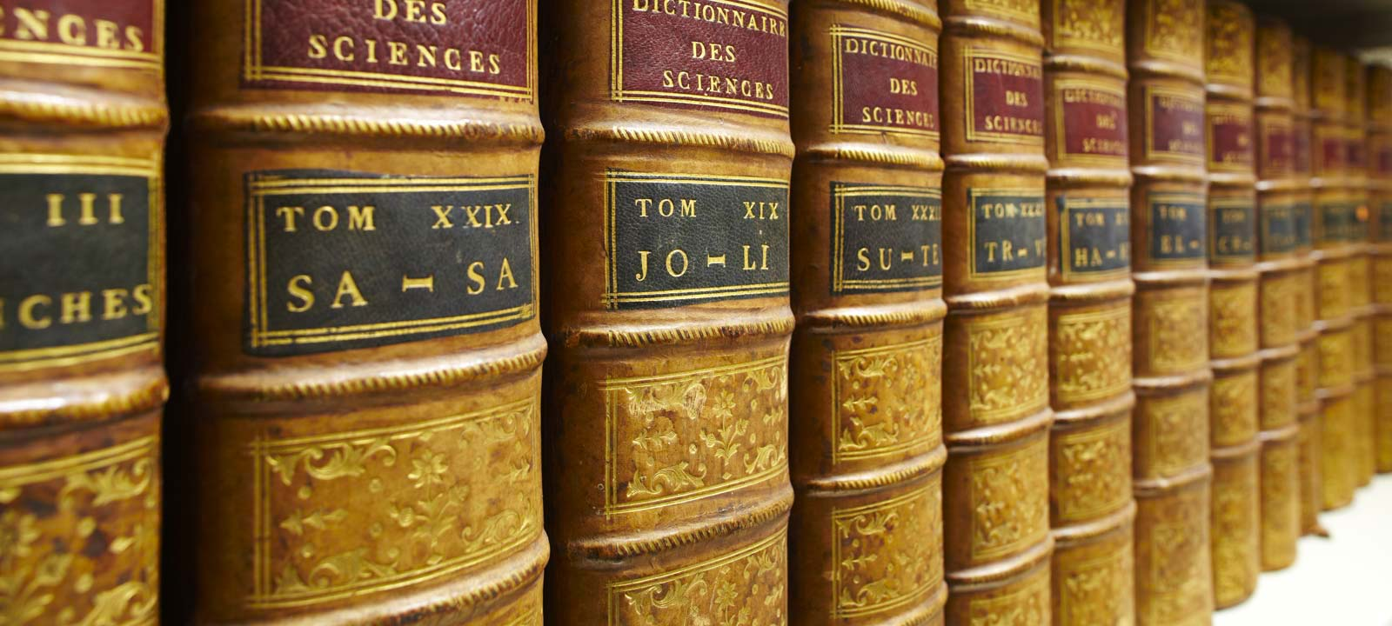
Denis Diderot and Jean Le Rond d’Alembert’s project of Encyclopedia
In 1751 – 1766 an outstanding project of Encyclopaedia, or a Systematic Dictionary of the Sciences, Arts, and Crafts was being published (26 volumes on the latest scientific and artistic acheivements)
Editor-in-chief – D. Diderot
Contributors: J. d’Alembert, E. Condillac, J.-J. Rousseau, C. А. Helvétius, C. L. de Montesquieu, Voltaire, А. R. J. Turgot
The principle of interrelation of knowledge

Slide 16
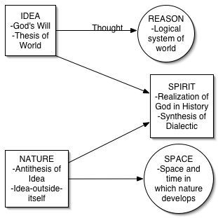
G. W. F. Hegel’s system of absolute idealism

Slide 17
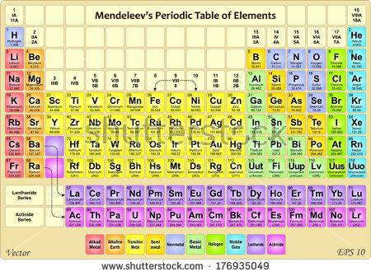

Slide 18
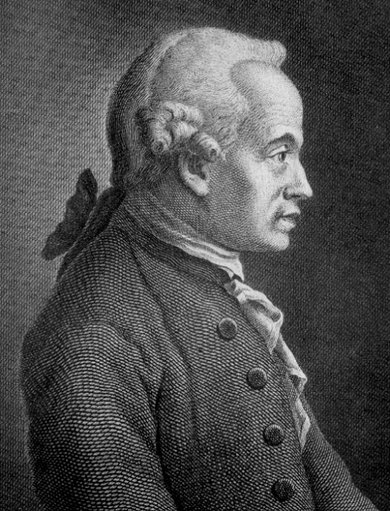
Immanuel Kant’s philosophy (1724 – 1804)
Kant’s doctrine’s motto is Sapere aude! Dare to know!
The field of philosophy in the universal and civil since may be reduced to the following questions:
1. What can I know?
2. What ought I to do?
3. What may I hope?
4. What is man?
«The first question is answered by Metaphysics, the second by Morals, the third by Religion and the fourth by Anthropology. In reality, however, all these might be reckoned under anthropology, since the first three questions refer to the last».

Slide 19
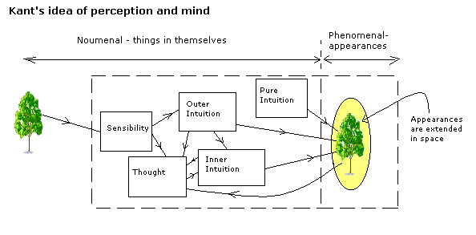
Transcendental (critical) philosophy
We need to establish our knowledge (which starts from experience) on the universal and essential (a priori) principles; these are the formal conditions of our experience
Transcendental VS empirical
A priori VS a posteriori
The term of ding an sich
Before we get any experience we possess two a priori forms of sensibility: time and space. They are not objective, but subjective (i.e. they exist in us, but neither in the objects, nor in the world)

Slide 20
Thank you for your attention!
camenes@yandex.ru
aspirantura@mail.ifmo.ru
St. Petersburg, 2016

